Slide 1
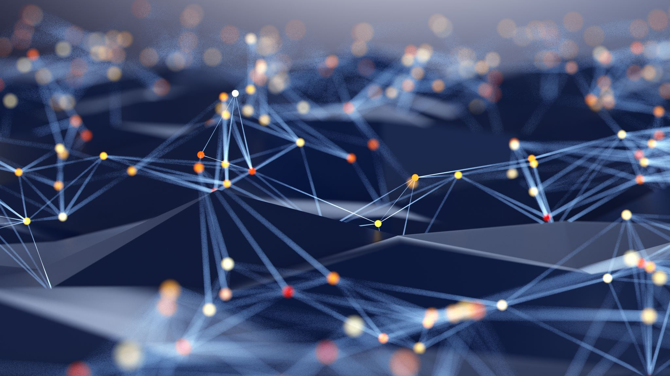
From DataFrames To Graph
Data Science with pyTigerGraph
Parker Erickson
Graph+AI World 2020

Slide 2

About Me
Senior at University of Minnesota pursuing a B.S. and M.S. in Computer Science
Creator of pyTigerGraph
Part time software engineer at Optum
Patent-pending inventor for a fraud detection algorithm using graph ML
Connect with me: https://www.linkedin.com/in/parker-erickson/

Slide 3
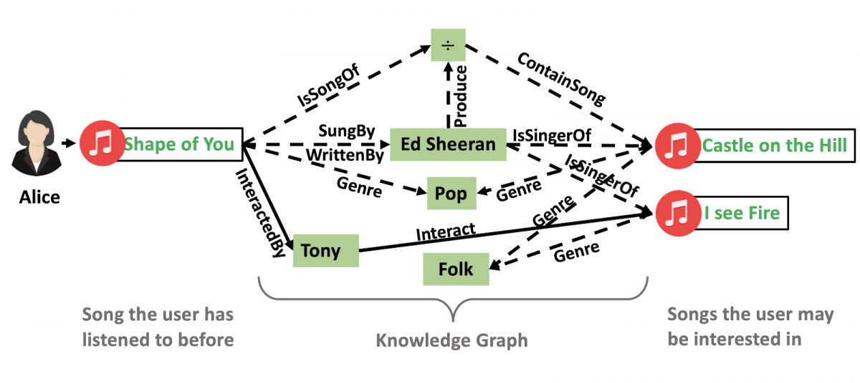
Why Graph?
Graphs not only store data, they store relationships between data in things like:
Social Networks
Fraud Rings
Recommendation Engines
Graphs can enable Explainable AI
https://tech.ebayinc.com/research/explainable-reasoning-over-knowledge-graphs-for-recommendation/

Slide 4
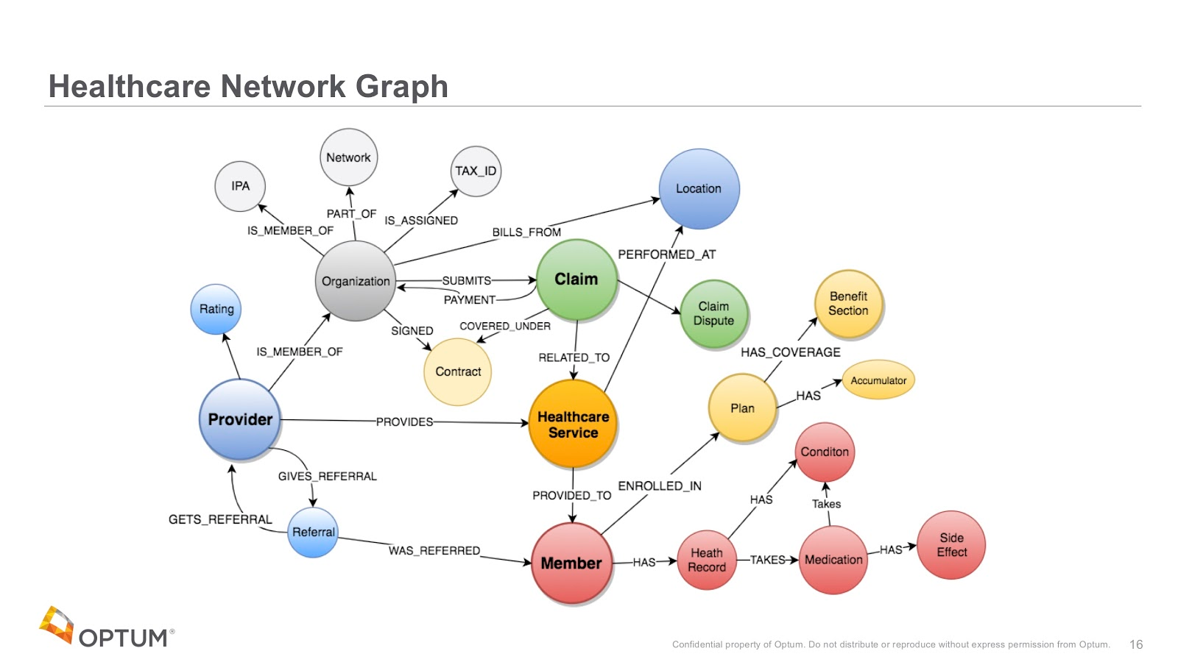
Graph in Industry
Optum
World’s Largest Healthcare Graph
10+ Billion Vertices
LinkedIn
Connection Graph
Amazon
Products, reviews, users, etc.
https://neo4j.com/blog/connected-healthcare-data-challenges-graphconnect/
https://www.optum.com/content/dam/optum3/optum/en/resources/publications/oreilly-state-of-healthcare-technology.pdf

Slide 5
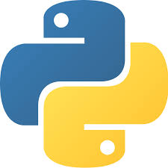
Enabling Graph Data Science
Many organizations have data scientists that are Python experts
Tools should be what they are comfortable with
No need to learn how to do complex GSQL queries
Focus on algorithms and analysis, not learning new languages

Slide 6
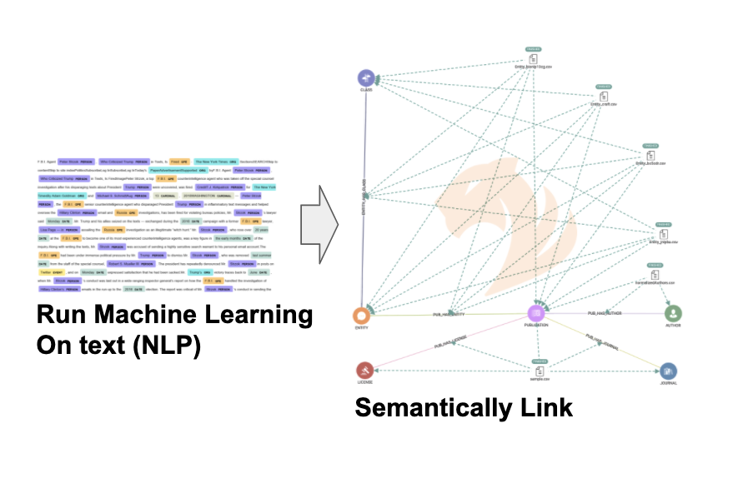
Traditional ML + Graph
Graph can accelerate traditional ML workflows
Lack of costly JOINs across tables accelerate development
Enrich knowledge graphs using outputs from ML algorithms
Sentiment Analysis
Entity Extraction

Slide 7
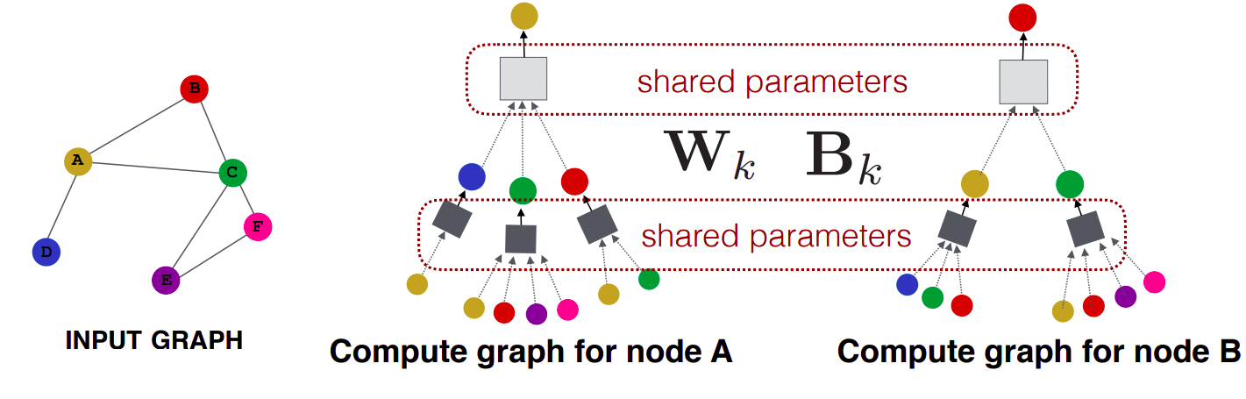
Graph Machine Learning
Node2Vec
Creates embeddings based off of random walks
Based off of Word2Vec
Graph Neural Networks
Uses “message passing” to generate representations of vertices in graph
Used for classification and regression tasks
Graph Convolutional Neural Networks (Kipf & Welling, 2017)
Graph Attention Networks (Veličković et al., 2018)
https://parkererickson.github.io/graph-ml/papers/
https://app.wandb.ai/yashkotadia/gatedgcn-pattern/reports/Part-1-Introduction-to-Graph-Neural-Networks-with-GatedGCN--VmlldzoyMDg4MjA

Slide 8

pyTigerGraph
pyTigerGraph enables data scientists to easily create, load, and analyze graph relationships
Opens the door to various graph machine learning algorithms, such as:
Node2Vec
Graph Convolutional Neural Networks
Graph Attention Networks

Slide 9
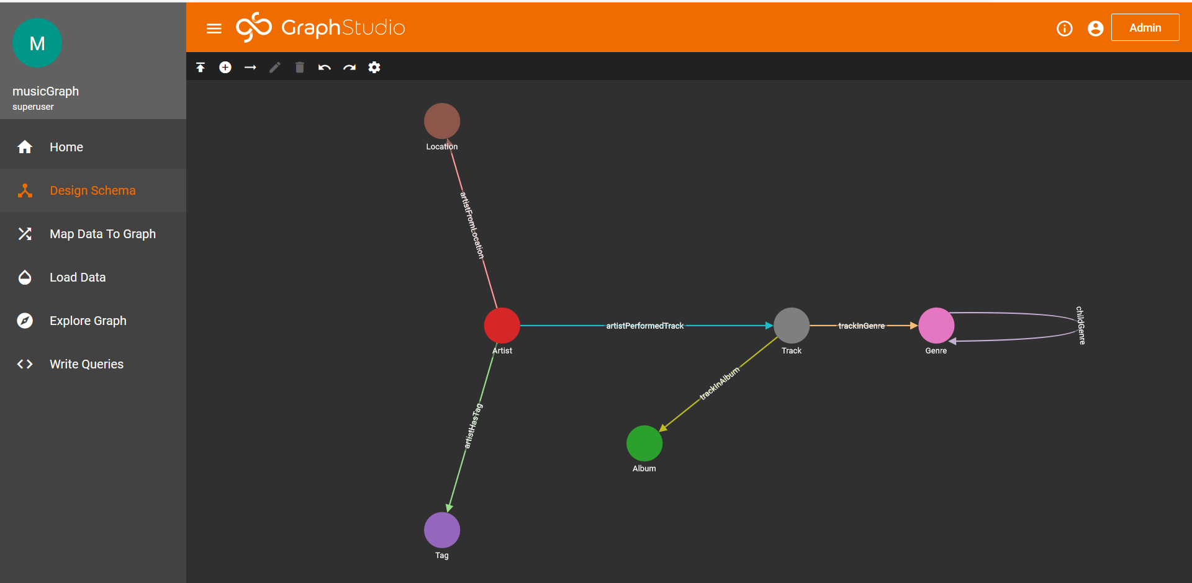
Demo

Slide 10
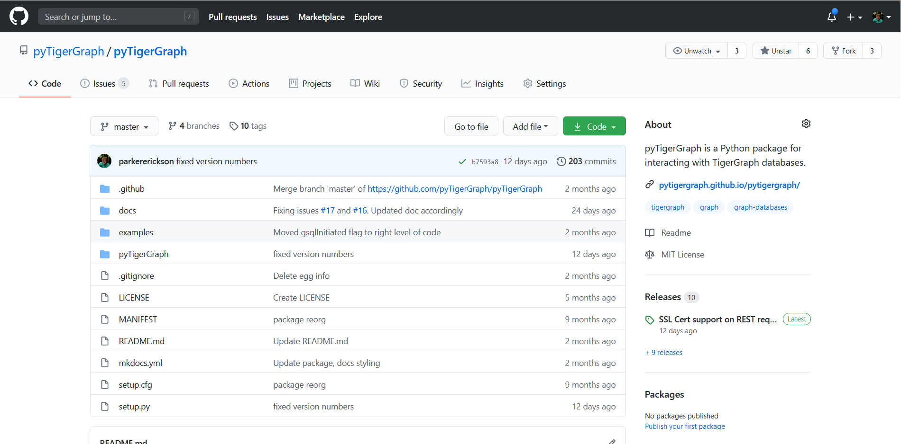
Contribute
Special thanks to:
Jon Herke – TigerGraph
Szilard Barany – TigerGraph
Yaniv Ben-Ami – Carleton College
Submit an Issue or Pull Request: https://github.com/pyTigerGraph/pyTigerGraph

Slide 11
Questions
Contact me at:
parker.erickson30@gmail.com
https://www.linkedin.com/in/parker-erickson/
Connect with the Community on Discord:
https://discord.gg/XM7Cn9w

